Slide 1
What is Open Source?

Slide 2

Free Software [ Free, Free Free!!!!]

Slide 3

Legally free to do whatever you want with your copies of a free* software (including profiting from them).
* : ultimate control over the software: regardless of how much is paid to obtain the software

Slide 4
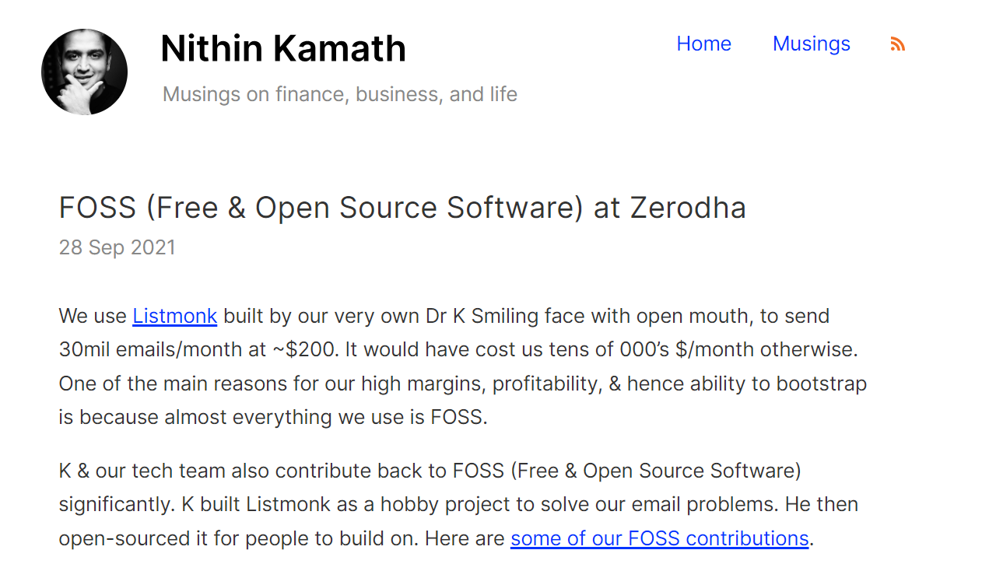

Slide 5
What is Open Source?
Open -> Collaboration is Open
Source - > Source is freely available
Share
Adapt
Modify
Collaborate

Slide 6

Open Source Initiative
Open Source Initiative (OSI) is a public benefit corporation
Founded in 1998
Actively engaged in building open source community
(https://opensource.org/)
2014 version of logo - from Simon Phipps
(https://commons.wikimedia.org/wiki/File:Opensource.svg)
India FOSS: https://indiafoss.net/ [Portal to organize and participate in free and open source software, hardware, and open data conferences in India under the FOSS United Foundation.]

Slide 7
What is Open Source Software?
The word “open source” refers to something users or people can use, modify and share since it is publicly available
free of cost
with uncontrolled accessibility
Open source software is the software with its source code being publically available for anyone to use, edit, inspect, modify, and distribute.
Programmers may use source code or may work to improvise an already existing source code by adding features to it, identifying and fixing bugs or enhancing it in some other form.

Slide 8
Examples of Open Source Software
Categories of Software | Open Source Software
Programming Languages | PHP, Python, Java
Presentation Software | Libre office’s Impress, Apache office’s Impress
Communication Software | FreeSWITCH, openPBX, Thunderbird
Content Management System | Joomla, PHP-Nuke, WordPress
Operating Systems | Fedora, Ubuntu, Linux, FreeBSD, OpenBSD
Databases | MySQL, PostgreSQL
Web Design Software | Brackets, Adobe Dreamweaver, GIMP
Web Browsers | Mozilla Firefox, Chromium, Arena
Source code management/Version control | Git, GitHub, Mercurial, Subversion
Application Servers | JBoss, Tomcat, Glassfish, WebSphere

Slide 9
What is Open Source Software?
From Wikipedia
(https://en.wikipedia.org/wiki/Open-source_software):
Open-source software (OSS) is a type of computer software in which source code is released under a license,
in which the copyright holder grants users the rights to use, study, change, and distribute the software to anyone and for any purpose.
Open-source software is usually developed in a collaborative public manner.
Open-source software is a prominent example of open collaboration.

Slide 10
What is Proprietary Software?
Proprietary software, also known as protected or restricted software
Usually owned by an organization or a group of people.
In order to use a proprietary software, end users must accept a license
Such licenses restrict the right of the user, in any of the following manner:
Restricted right of re-distribution
Restrictions on reconstructing source code
Restricted ways in which the product can be used or embedded within another product

Slide 11
What is Proprietary Software?
From Wikipedia
(https://en.wikipedia.org/wiki/Proprietary_software):
Proprietary software, also known as non-free software, or closed-source software, is computer software for which the software's publisher or the owner retains intellectual property rights — usually copyright of the source code, and also sometimes patent rights.

Slide 12
Examples of Proprietary Software
Categories of Software | Proprietary Software
Programming Languages | MATLAB, VBScript
Presentation Software | MS-Office
Content Management System | Adobe Experience Manager, Kentico, SiteCore
Operating Systems | Windows, Mac OS, Apple iOS Mobile Operating System
Databases | Oracle, DB2, Microsoft SQL Server, Informix Dynamic Server, SQL Anywhere
Web Browsers | Apple Safari Browser, Internet Explorer
Source code management/Version control | PerForce, Microsoft Team Foundation Server
Application Servers | Weblogic, Sybase Enterprise Application Server

Slide 13
More on Proprietary Software
Until recently, proprietary software was the only real model that was used by commercial software.
In proprietary software, the source code is only available with the owner organization
Some trusted partners may be given rights to use the same – under the jurisdiction of the non-disclosure agreement (NDA). For example:
Amazon shares its API with trusted partners
vs. Google API available for all

Slide 14
Principles of Open Source Software
Openness: Publishing the design and source code of a software to public – with intent that
Openly fixed or contributed to
Openly scrutinised / criticized
Open feedback obtained
Analysed for bugs or defects
Analysed for quality

Slide 15
Principles of Open Source Software
Transparency: ability of the community to see the current progress and future plans
Project roadmap is made available to the community
A defect tracking system is put in place – for reporting and reviewing defects
Publish design documents
Transparency and Openness are not same
Transparency – same as a glass door – you allow an outsider to view what’s happening inside
Openness – you allow the outsider to enter inside and contribute

Slide 16
Principles of Open Source Software
Early and Often
Any changes proposed or made by any one are made public immediately
Contributions are expected to occur early – resolving errors early in development lifecycle
Contributions are expected to occur often – changes shared with others immediately / regularly
Expectation of Community
Participants in an Open Source project have expectations of a community – to be formed – that works together – to contribute to the development of the project

Slide 17
Advantages of OSS
Low cost: OSS usually does not require a licensing fee, hence free of cost
Flexible: Can be modified by anyone and tailored to suit specific business needs
Quality and Reliability: One needs to identify and select an OSS that suits your business needs and is of good quality. Usually, a mature OSS is generally viewed to be of good quality and considered to be more reliable

Slide 18
Advantages of OSS
Vendor independence: In case of use of proprietary software, there is usually a contract with a specific vendor (involving high costs, restricted usage). This is overcome in OSS
Availability of External Support Services: External technical support services by vendors are available for quite a few of the OSS. For example:
Red Hat (now owned by IBM) provides support for many OSS
MySQL support provided by the parent company MySQL AB – now owned by Oracle
Several open source products have active online community support

Slide 19
Disadvantages of OSS
Lack of personalized support services: Unlike proprietary software, OSS products or packages do not come with personalized support facility over phone or e-mail
However, for some mature OSS, there might be some commercial service providers that may provide support services
Limited choices of OSS products
Continuous Change: Continuous changes are made to open source software – difficult to get a compatible, and bug-free version at a particular time
No warranty: No warranty support is provided along with OSS since it is not owned by a single company.

Slide 20
Is Open Source Software actually free?
Although OSS is usually free there are some hidden costs associated with it:
Total Cost of Ownership (TCO) – which involves:
cost associated with adopting and managing the software in your organization
cost of additional services or products required (e.g. access to software updates, support services)
Switching cost – which involves
cost associated with migrating data from the older system to the new ones
training cost – through internal resources or from a third-party

Slide 21
Is Open Source Software actually free?
Additional costs of:
Evaluating and selecting the most suitable open source software for your organization
Integrating the selected open source software into the internal organizational system
Fixing any critical defects found
Participating in online communities related to the particular software to keep upfront with the latest advances in that software
Train users and/ or technical staff

Slide 22
History of Open Source Software
In the beginning, in 1960s, all software was free
computer companies sold computer hardware; these machines came bundled with the software which was provided free of cost.
Software was not seen as a product. It was freely shared with the users
Software was written in a programming language and it could be easily improved and modified.
This was beneficial to the manufacturers since people were able to write / modify software, that made their machines more useful
Adapted from: http://eu.conecta.it/paper/brief_history_open_source.html

Slide 23
History of Open Source Software
Later, in the early 1970’s, with the emergence of operating systems and compilers, proprietary software started to dominate the software landscape
Manufacturers no longer bundled source code with the hardware; software had to be bought separately.
Companies realized that most users couldn’t or didn’t want to “fix” their own software and
There was money to be made in leasing or licensing software.
Legal restrictions were associated with software through copyrights, trademarks, and leasing contracts.
Adapted from http://eu.conecta.it/paper/brief_history_open_source.html

Slide 24
History of Open Source Software
In late 1970 -80s, two groups, both in United States, started with what later came to be known as the Open Source Software movement.
In 1984, in the East Coast, Richard Stallman (who formerly worked as a programmer at the MIT AI Lab) launched the GNU Project, which aimed at developing a free operating system.
EMACS editor was also created as a part of this project and is a powerful text editor.
Later, in 1985, he created the Free Software Foundation - a non-profit organization – with the aim to eliminate restrictions on redistribution, copying, and modification of software.
Later, in 1987, he created the GNU C Compiler (GCC), an open source compiler, in order to encourage open source code contributions.
Adapted from http://eu.conecta.it/paper/brief_history_open_source.html

Slide 25
History of Open Source Software
FSF also proposed the GPL or the GNU General Public License
This license was designed to ensure that the software produced by GNU remain free,
and to encourage production of more free software
In the West coast, the Computer Science Research Group (CSRG) at the University of California (Berkeley) started to work on improvising the Unix system or the “BSD Unix.
With the advent of Internet user group – known as Usenet - several communities started to collaborate and contribute to each other’s work……
The Open Source Software Movement had started…..
Adapted from http://eu.conecta.it/paper/brief_history_open_source.html

Slide 26
History of Open Source Software
In 1991, Linus Torvalds (a student at the University of Helsinki in Finland), created the Linux® kernel
This was made possible with the help of several volunteer students through Usenet.
Eventually, the kernel grew with the help of several of developers around the world, and emerged into an open source software.
Few years later, this was released as a complete open source operating system called the GNU/Linux.

Slide 27
History of Open Source Software
It was in 1994, when the first open source web server was launched – named Apache HTTP server
It was developed by Robert McCool
This proved to be an important event in the history of open source movement, since this web server played a significant role in the development of the World Wide Web
It was the first open source alternative to the Netscape Web server

